Slide 1

Transport Demand Prediction
Transport Demand Prediction
Machine Learning Forecasting | by Roshani Nayak
Machine Learning Forecasting | train_revised.csv

Slide 2

Introduction
Project goal: Predict number of seats sold for travel routes.
Dataset: booking details (ride info, payment, datetime, origin/destination, car type, capacity).
Objective: Optimize operations & resource allocation.

Slide 3
Main Libraries used :
• Pandas for data manipulation, aggregation
• Matplotlib and Seaborn for visualization and behaviour with respect to the target variable
• NumPy for computationally efficient operations
• Scikit Learn for model training, model optimization, and metrics calculation

Slide 4

Data Preprocessing & Feature Engineering
- Imported the libraries.
- loaded the dataset using pandas library.
- Dropped irrelevant identifiers(payment_reciept).
- Combined date & time into datetime.
- Encoded categorical variables.
- Extracted time-based features (year, month, weekday, hour).
- Created features: arrival times, peak traffic, holidays.

Slide 5
Title
Exploratory Data Analysis

Slide 6
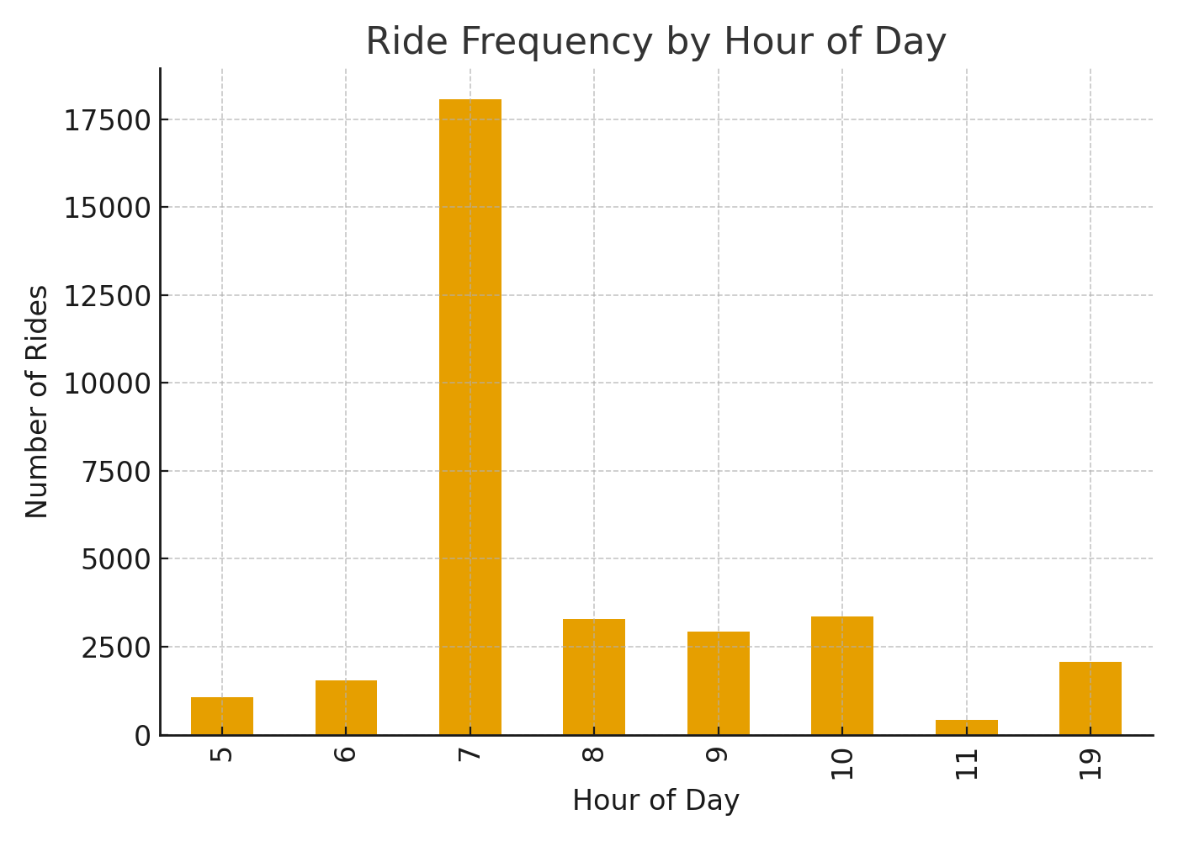
Exploratory Data Analysis
Most rides occur in the morning (peak at 7 AM)
Smaller evening peak around 7 PM
Seasonal variation in demand observed

Slide 7
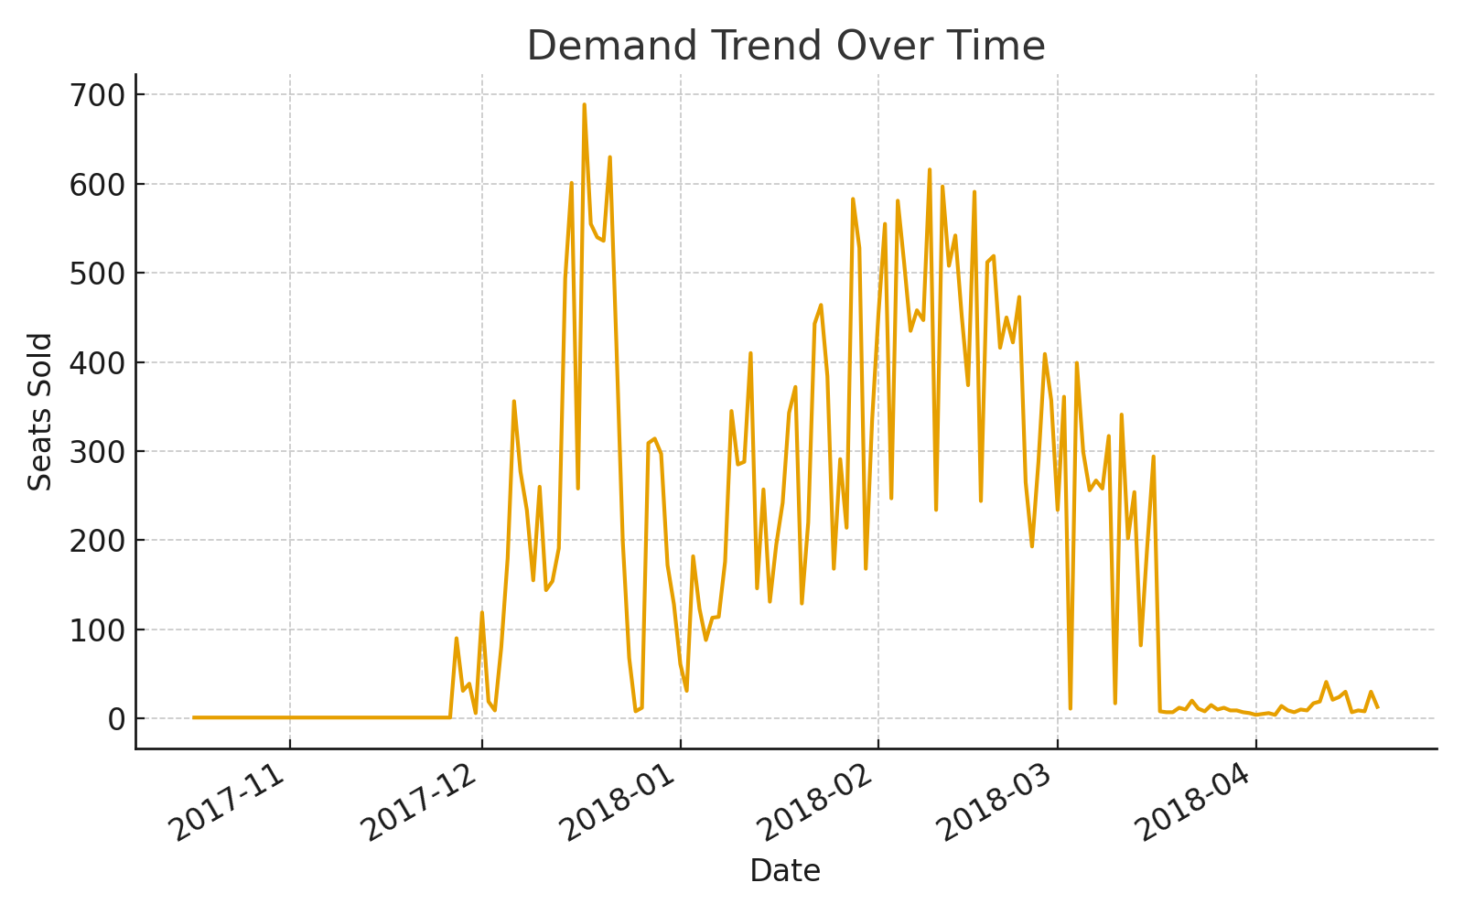
Demand Trend Over Time
Booking demand fluctuates over time, showing clear peaks during certain months and days.

Slide 8
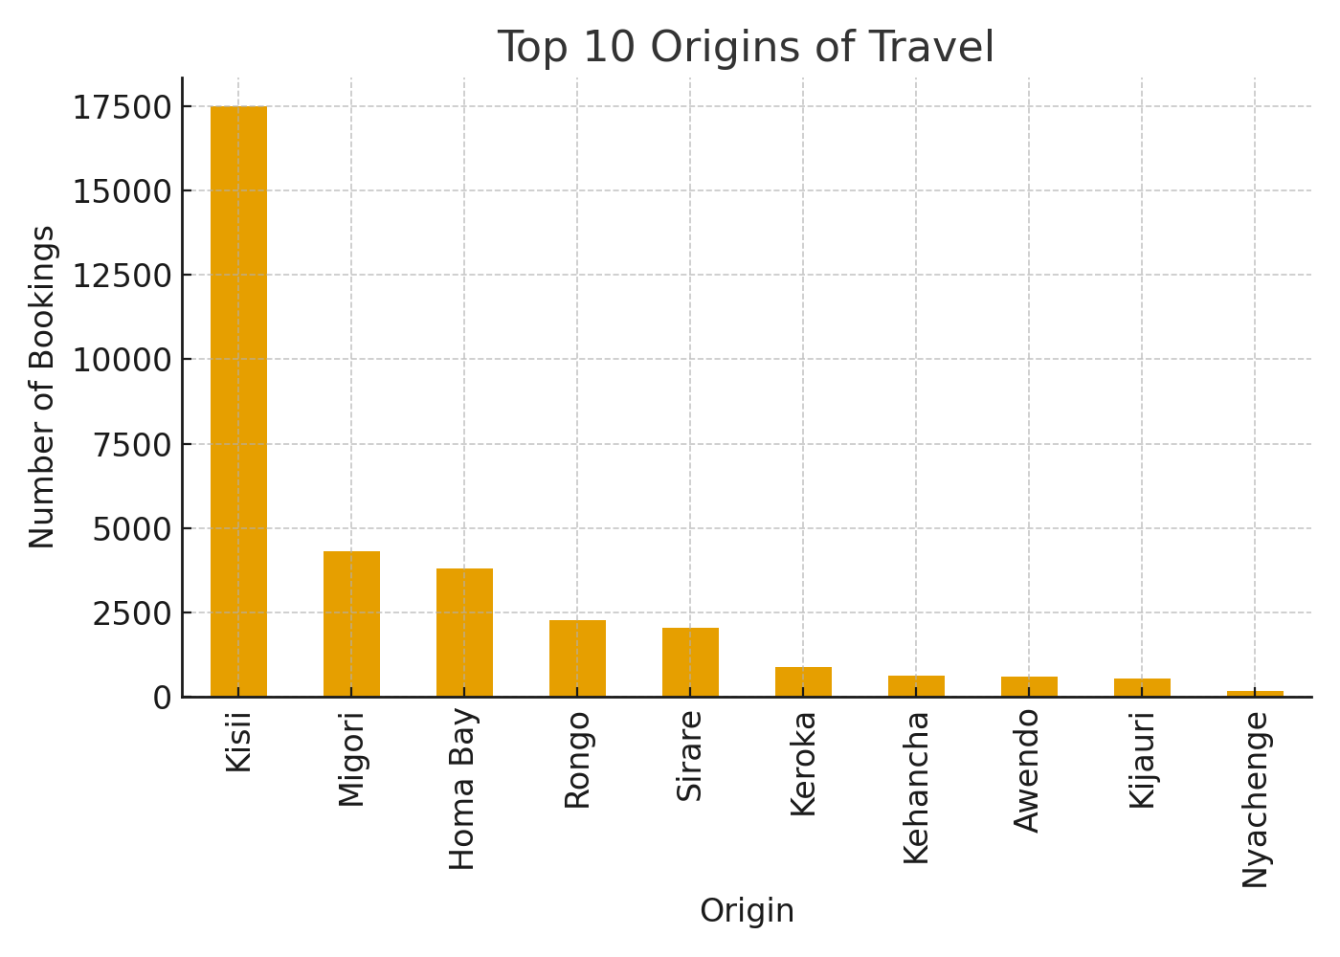
Top Travel Origins
Top 10 most common starting points for travel demand.

Slide 9

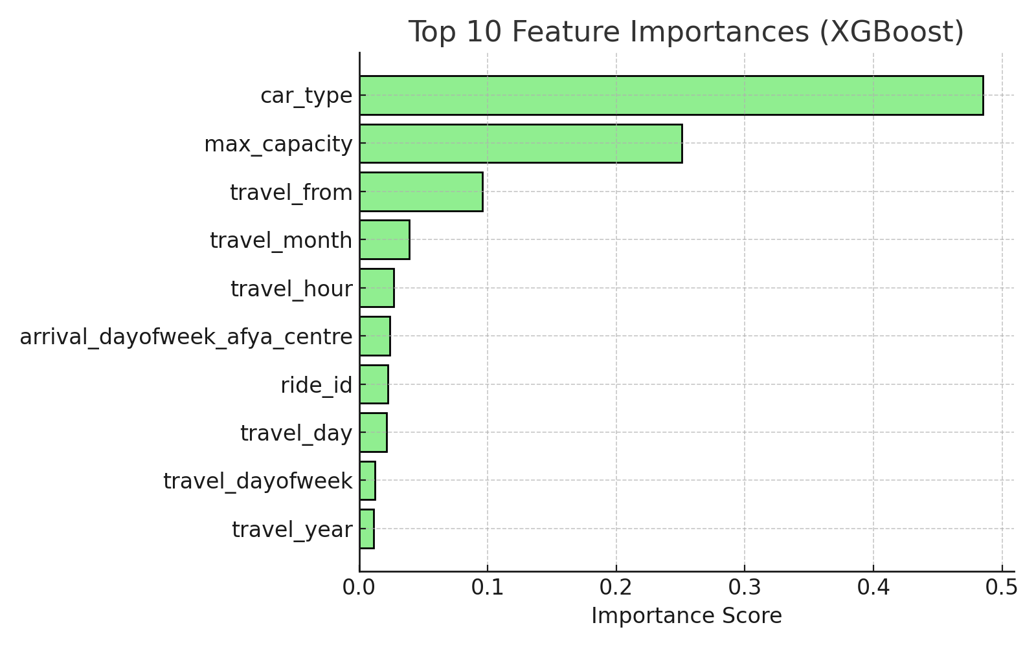
Feature Importance
Most influential features for predicting demand:
- Car Type
- Max Capacity
- Travel Origin
- Time-based features (Month, Hour, Day)

Slide 10

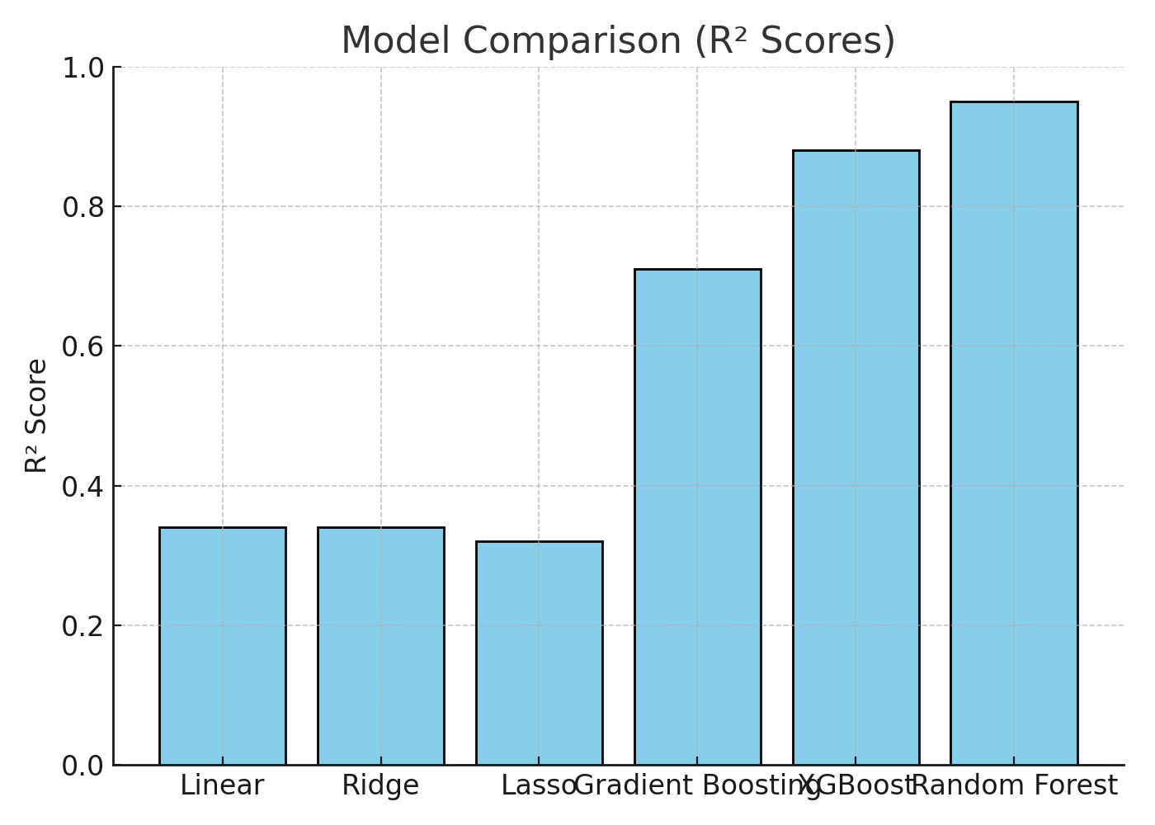
Model Testing & Results
Models tested:
- Linear, Ridge, Lasso → R² ≈ 0.3
- Gradient Boosting → R² = 0.71
- XGBoost → R² = 0.88
- Random Forest → R² = 0.95
Random Forest was the best-performing model.

Slide 11
Conclusion
✓ Tuned Random Forest performed best (MAE = 1.21, RMSE = 2.44, R² = 0.95)
✓ Outlier removal did not improve results
✓ Key drivers: Car Type, Capacity, Origin
The model provides valuable insights for demand forecasting.

